Slide 1
TNE20002/TNE70003
Topic 2: RIP Routing Protocol
V1.0

Slide 2
Routing Protocols
Routing Protocols
facilitate
the exchange of
routing information
between routers
Notes:
3.1.1.2 Purpose of Dynamic Routing Protocols

Slide 3
Routing Protocols
Discover remote networks
Determine least cost paths to destination networks
Maintain up-to-date routing information in tables
Find a new least cost path if the current path is no longer
available
Notes:
3.1.1.2 Purpose of Dynamic Routing Protocols

Slide 4
Routing Protocols
Main components include:
Data structures – A Routing Protocol uses tables for its operations. These tables are stored in RAM.
Routing protocol messages
To discover neighboring routers,
To exchange routing information,
To learn and maintain accurate information about the
network.
Algorithm - for least cost path determination.
Notes:
3.1.1.2 Purpose of Dynamic Routing Protocols (cont.)

Slide 5
Routing Protocols
The routing table
contains
only
the least cost paths
to destination networks
Notes:
3.1.1.2 Purpose of Dynamic Routing Protocols

Slide 6
Routing Protocols: Network Convergence
The network has converged when all routers have complete and accurate information (in their tables) about the network topology.
Not Instantaneous
It takes time for routers to
share information (collaborate with other routers),
determine least cost paths (independent of other routers),
update their tables

Slide 7
Routing Protocols – RIP
From
COLD Start
To
Network Convergence
Notes:
3.1.3.5 Achieving Convergence

Slide 8
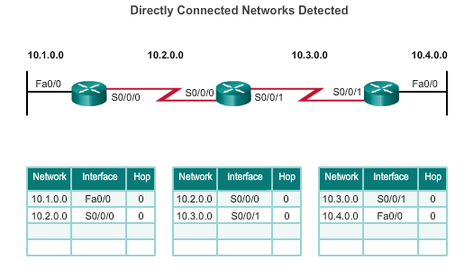
Operation - Cold Start
Directly Connected Networks Detected and Added to Routing Table
R1
Hop
R2
R3
Routers running RIPv2
Notes:
3.1.3.2 Cold Start

Slide 9
Operation - Cold Start
R1 adds the 10.1.0.0 network available through Fa0/0 and 10.2.0.0 is available through S0/0/0.
R2 adds the 10.2.0.0 network available through S0/0/0 and 10.3.0.0 is available through S0/0/1.
R3 adds the 10.3.0.0 network available through S0/0/1 and 10.4.0.0 is available through Fa0/0.
Directly Connected Networks Detected and Added to Routing Table
Notes:
3.1.3.2 Cold Start

Slide 10
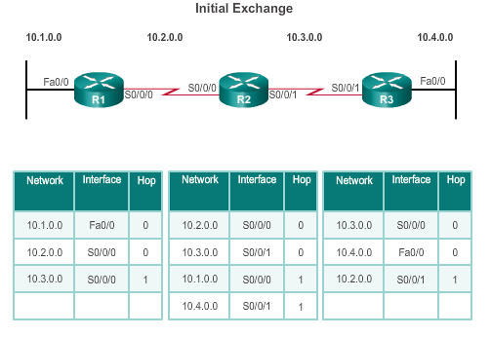
Operation – Exchanging Information
Routers running RIPv2
R1:
Sends an update about network 10.1.0.0 out S0/0/0
Sends an update about network 10.2.0.0 out Fa0/0
Receives update from R2 about network 10.3.0.0 with a cost of 1 hop
Stores network 10.3.0.0 in the routing table with a cost of 1 hop
Notes:
3.1.3.3 Network Discovery

Slide 11
Operation - Exchanging Information
Routers running RIPv2
R2:
Sends an update about network 10.3.0.0 out S0/0/0
Sends an update about network 10.2.0.0 out S0/0/1
Receives an update from R1 about network 10.1.0.0 with a cost of 1
Stores network 10.1.0.0 in the routing table with a cost of 1
Receives an update from R3 about network 10.4.0.0 with a cost of 1
Stores network 10.4.0.0 in the routing table with a cost of 1
Notes:
3.1.3.3 Network Discovery (cont.)

Slide 12
Operation - Exchanging Information
Routers running RIPv2
R3:
Sends an update about network 10.4.0.0 out S0/0/1
Sends an update about network 10.3.0.0 out Fa0/0
Receives an update from R2 about network 10.2.0.0 with a cost of 1
Stores network 10.2.0.0 in the routing table with a cost of 1
Notes:
3.1.3.3 Network Discovery (cont.)

Slide 13
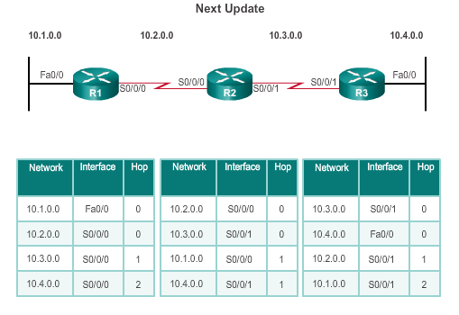
Operation – Exchanging Information
Routers running RIPv2
R1:
Sends an update about network 10.1.0.0 out the S0/0/0
Sends an update about networks 10.2.0.0 and 10.3.0.0 out the Fa0/0
Receives an update from R2 about network 10.4.0.0 with a cost of 2
Stores network 10.4.0.0 in the routing table with a cost of 2
Notes:
3.1.3.4 Exchanging the Routing Information

Slide 14
Operation - Exchanging Information
Routers running RIPv2
R2:
Sends an update about networks 10.3.0.0 and 10.4.0.0 out S0/0/0
Sends an update about networks 10.1.0.0 and 10.2.0.0 out S0/0/1
Receives an update from R1 about network 10.1.0.0. There is no change, therefore, the routing information remains the same.
Receives an update from R3 about network 10.4.0.0. There is no change, therefore, the routing information remains the same.
Notes:
3.1.3.4 Exchanging the Routing Information (cont.)

Slide 15
!! Convergence Achieved !!
Routers running RIPv2
R3:
Sends an update about network 10.4.0.0 out S0/0/1
Sends an update about networks 10.2 0.0 and 10.3.0.0 out Fa0/0
Receives an update from R2 about network 10.1.0.0 with a cost of 2
Stores network 10.1.0.0 in the routing table with a cost of 2
Receives an update from R2 about network 10.2.0.0 with a cost of 1. There is no change; therefore, the routing information remains the same.
Notes:
3.1.3.4 Exchanging the Routing Information (cont.)

Slide 16
RIPv2

Slide 17
RIPv2
RFC 1723 – 1994, RFC 2453 - 1998
Uses well known port 520
Administrative distance 120
Metric Hop Count
Maximum Hop Limit 15
Supports VLSM, includes subnet mask in RIP update
Next hop address is included in update
Periodic updates every 30 secs
Triggered updates on link failure
Routing updates are multicast, 224.0.0.9
Use debug ip rip to view multicasting of updates
The use of authentication is an option

Slide 18
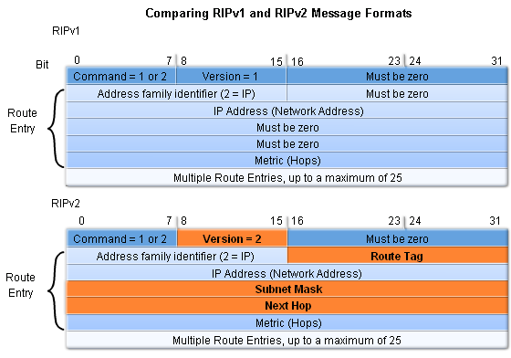
Comparing RIPv2 & RIPv1 Message Formats
RIPv2 Message format has extensions:
A subnet mask field
The addition of next hop address

Slide 19
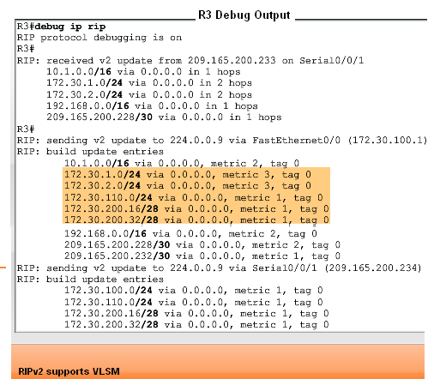
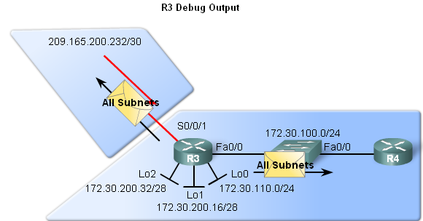
RIPv2 – Updates include (VLSM) Subnet Masks
Use the debug ip rip

Slide 20
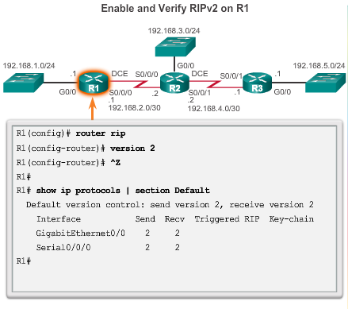
Enabling RIPv2
Notes:
3.3.1.4 Enabling RIPv2

Slide 21
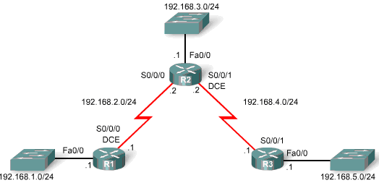
RIPv2 – Advertising Directly Connected Networks
The network Command:
Specifies network to be advertised
Enables RIP on all interfaces that belong to the networks
You advertise, only the directly connected networks, on any given router
R1(config)# router rip
R1(config-router) version 2
R1(config-router) network 192.168.1.0
R1(config-router) network 192.168.2.0
R2(config)# router rip
R2(config-router) version 2
R2(config-router) network 192.168.2.0
R2(config-router) network 192.168.3.0
R2(config-router) network 192.168.4.0
R3(config)# router rip
R3(config-router) version 2
R3(config-router) network 192.168.4.0
R3(config-router) network 192.168.5.0

Slide 22
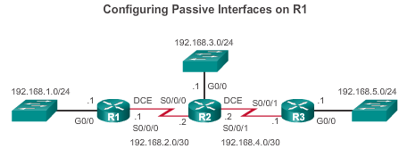
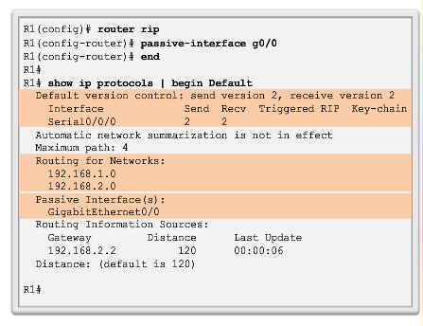
Configuring Passive Interfaces R1
Sending out unneeded updates to LANs impacts the network:
Wasted Bandwidth on Link
Wasted CPU Resources on PCs
Security Risk, routing tables reveal network topology
PC2
PC1
PC3
Notes:
3.3.1.6 Configuring Passive Interfaces

Slide 23
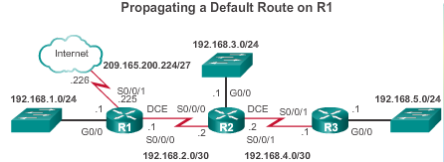
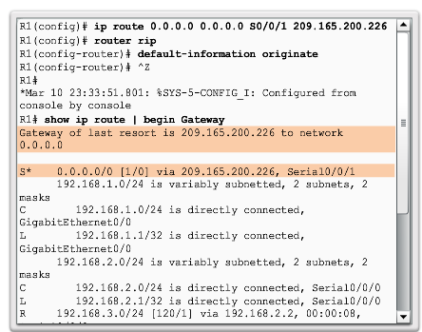
R1 Gateway Propagating a Default Route to R2,R3
Notes:
3.3.1.7 Propagating a Default Route

Slide 24

InLabScenario1_RIP_S2_2021_V1.0.pptx
In Lab Scenario 1 RIP Routing Protocol – V1.0
A Network Configuration and Trouble Shooting Scenario
Network Topology
“The Internet”
Loopback 0
181.25.0.0/16
External Web Server 1
Loopback 0
Server LAN
Database Server
Tandur
(Internal)
Router
R1
Sedam
(Gateway)
Router
R2
S0/1/1
S0/1/1
ISP
Router
R3
Loopback 1
22.0.0.0/8
External Web Server 2
S0/1/0
S0/1/0
Internal Serial
ISP Link
Network Address
201.24.4W.0/30
Loopback 2
155.2.0.0/16
External Web Server 3
G0/0/1
Loopback 3
211.31.8.0/24
External Web Server 4
All other web sites etc
Internal
Trunk for Inter-VLAN
Routing
External
RIPv2 Routing Protocol
Corporate Network Address
158.VZ.0.0/16
G1/0/11
Tandur
Switch S3
3650
G1/0/1
VLAN1
WRS1
Wireless
Router
G1/0/13
Internet Port
VLAN1
IP address
PC1
VLANXXX
PC2
VLANYYY
Wireless
Connection
Mobile
Wireless
PC
PC Ethernet VM
If in lab
PC VAN VM
If in lab

Slide 25
END

